Slide 1
Scrabble Assistant (29)
Team fmss (Link)
Fanish Jain(2018101021, CSE)
Swastik Murawat(2018101022,CSE)
Swati Dantu(2020702014,ECE)
Mayank Goyal(2018101002,CSE)
Mentor TA: Surendra Kumar Reddy

Slide 2
Contents:
About Scrabble
Goals of the Project
Results of the Project
Algorithms/Steps
Conclusion

Slide 3
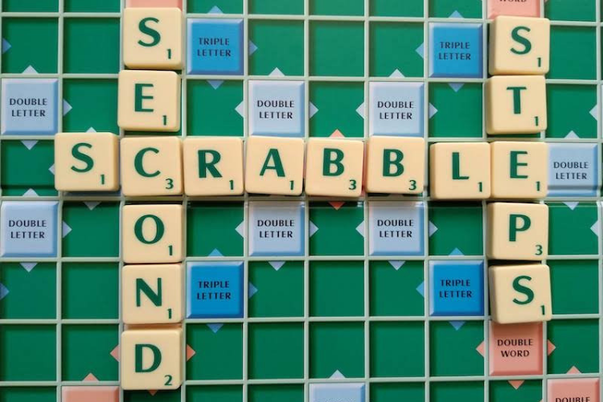
About Scrabble!
Scrabble is a commonly played word game in which players take turns forming words using a set of seven letter tiles and placing them onto a grid, following placement rules similar to a crossword puzzle.
Points are awarded based on the sum of values of individual letters, along with letter and word multipliers positioned regularly throughout the board.

Slide 4
Goals of the Project
A Software using image processing tools which identifies the current board state from a single image of the Scrabble board.
Account for small amounts of blurring during image capture
Identify tiles within the input image, even if the image is subjected to perspective skew, rotation, and scale.
Extract letters from the tiles. (Character Recognition)
Write about hint generation and score (Bonus)

Slide 5
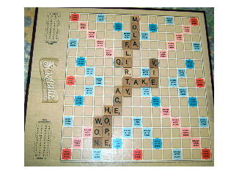
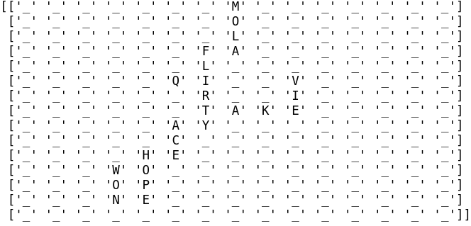
Result of the Project
Our software detects the characters from a Scrabble board and outputs the character matrix with very high accuracy

Slide 6
Algorithm/Steps
Perspective Skew Correction
Image Enhancement
Character Recognition

Slide 7
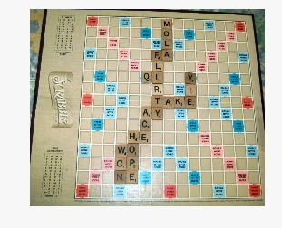
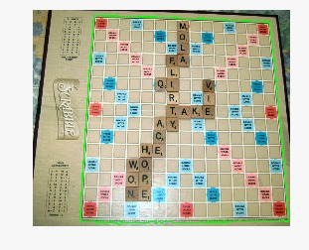
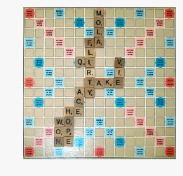
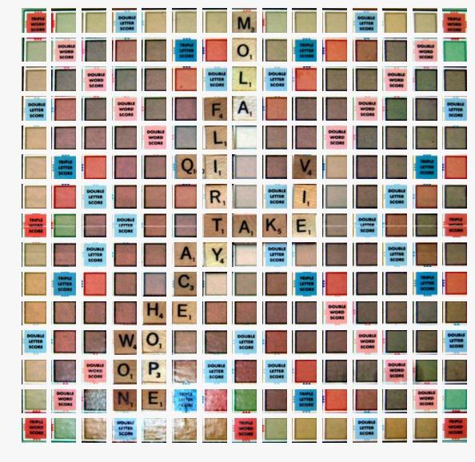
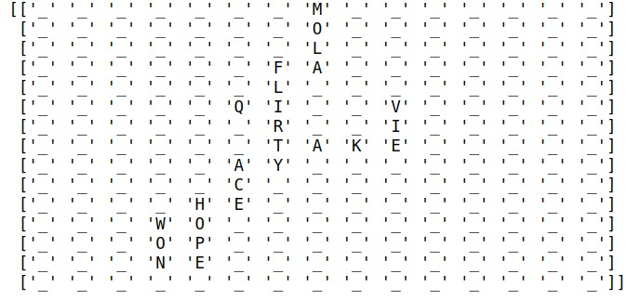
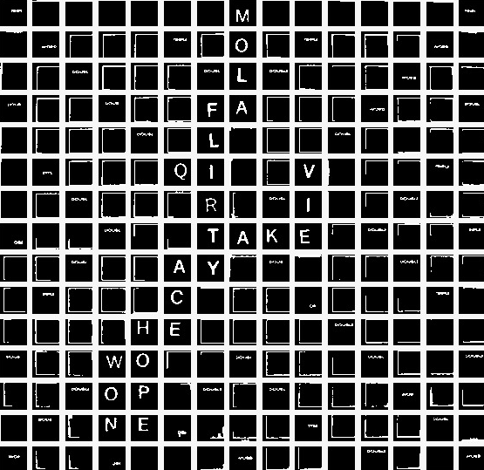
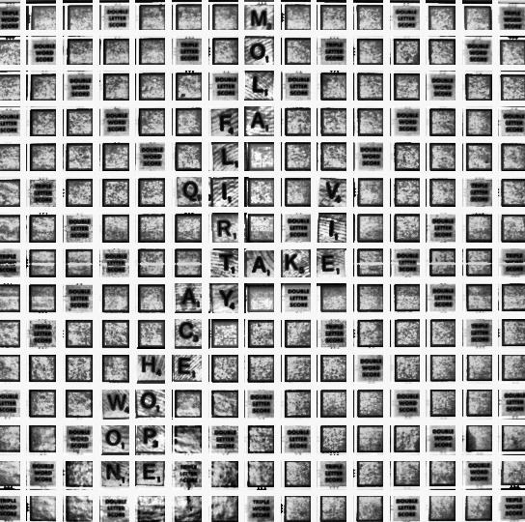
1
2
3
4
7
6
5

Slide 8
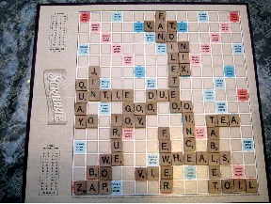
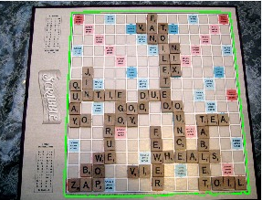
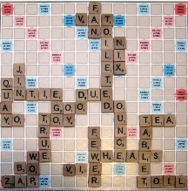
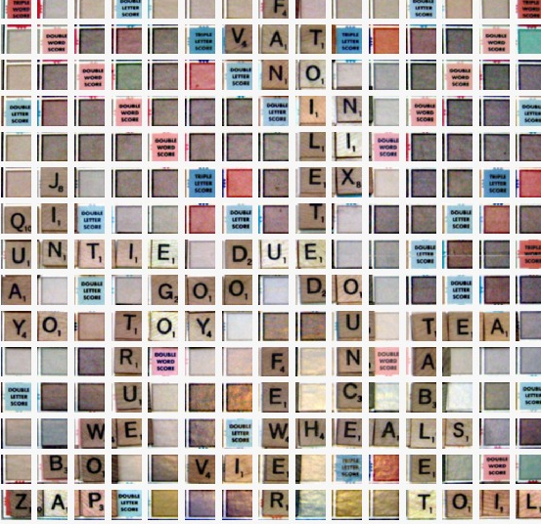
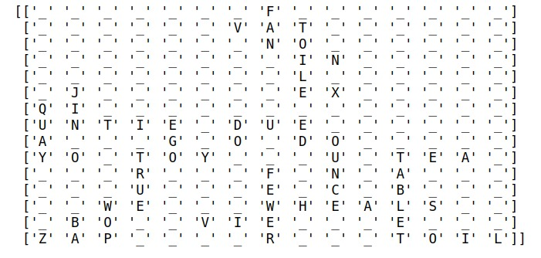
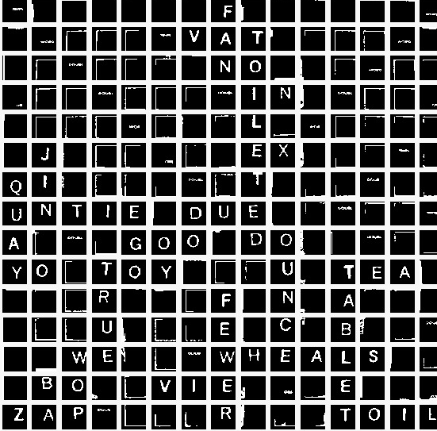
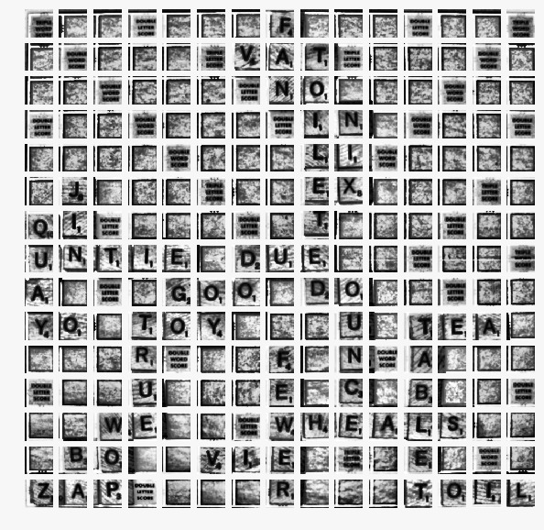
1
2
3
4
7
6
5

Slide 9
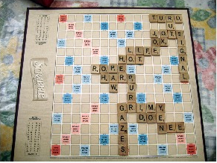
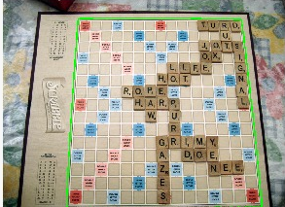
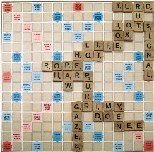
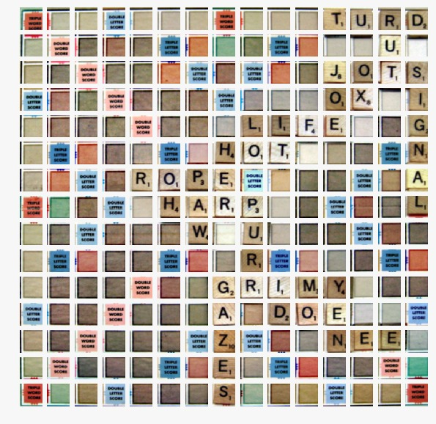
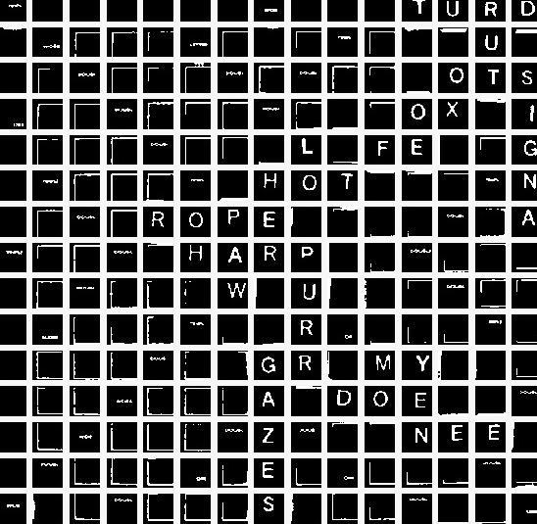
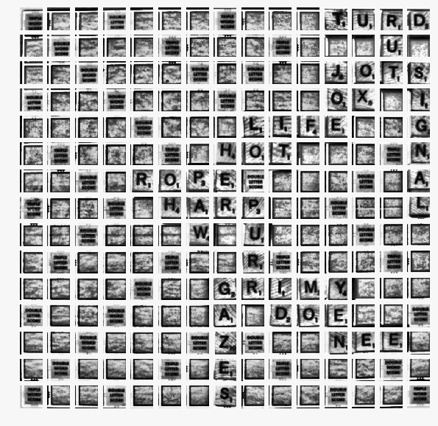
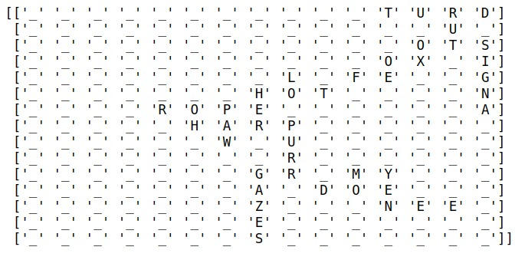
1
2
3
4
6
5
7

Slide 10
Perspective Skew Correction
1
Get contour (Largest one)
Warp image according to it
Now, for getting each tile we used ‘slice_image’ function
This function is written instead of grid detection (which is more accurate but complex to write)
2
3
Notes:
Meri zindagi ka

Slide 11
Image Enhancement
1
Contrast Stretching
Histogram Equalisation
Thresholding on each cell
4
3
2
Notes:
Meri zindagi ka

Slide 12
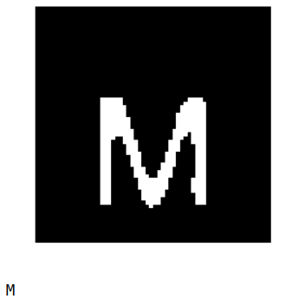
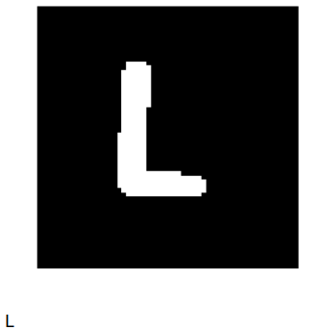
Character Recognition
Using pytesseract library for Character recognition.
For letter I using naive method.
Before character recognition several steps are applied to improve accuracy like contrast, Hist, Equalization, component
In case of character like T,J ,Z,C,D we use erosion followed by pytesseract to remove false result

Slide 13
Different approaches to character recognition
Approach I:
Applying tesseract directly on the input image after filtering and thresholding .
Problem: Creating a general function that works for all the image.
Approach II:
Resizing each grid cell to a fixed size and counting the number of white cell and mapping it to a letter based on some initially stored info.
Problem: For many characters number of white cells are same which creates ambiguity.
Approach III:
Isolating the characters with Marginally Isolating Stable Regions(MSER) , which is a blob detection algorithm.
Problem: Since the scrabble board also contain grids with ‘double/triple word score’ , the algorithm detected them as blobs as well and so the output contained these along with the alphabets.

Slide 14
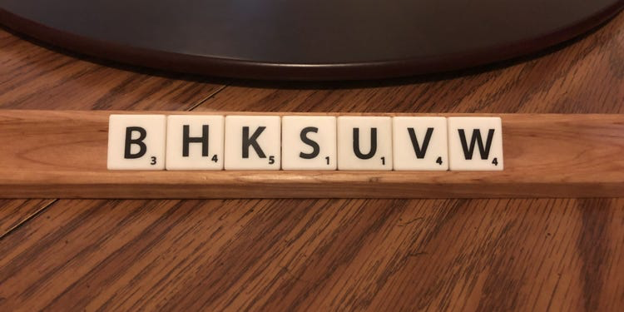
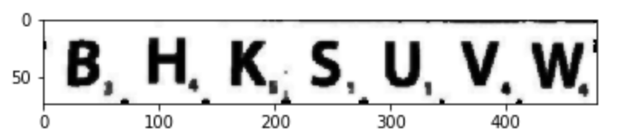
Hint generation
Crop the image to get the 7 letters
Binarize it and obtain the characters
Obtain different combinations of the alphabets to form words and compare it with the words in the twl. Twl is a scrabble 515KB scrabble word library
For the valid words , calculate the score.
1
2
3

Slide 15
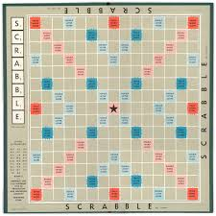
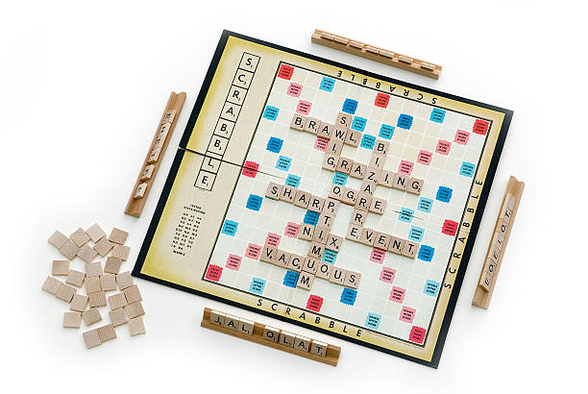
Challenges faced
In classifying letters, the system had to ignore extraneous characters in the scene, including characters that are part of the game board design and numbers written on the tile.
Although the input image is assumed to have small skew, even small viewing angles can affect the simple strategy later used to map character regions to a 15 x 15 matrix.
Pytesseract wasn’t able to detect “I” so we had to write a separate function to detect it.

Slide 16
Future Work
Although the algorithm works well on Images with small amount of perspective skew, but it still needs to be improved on images with larger skew.
The character recognition method we used in the project is done using the Pytesseract library, in future several different methods could be tried for better accuracies like ML model, template matching.
This algorithm is currently implemented in Python. In the future, it could be ported for use as a mobile application.

Slide 17
Division of Work
Swastik | Mayank | Fanish | Swati
Character Recognition | Improvisation | Perspective Skew Correction | Word Hint Generation and scoring
Image Enhancement | Documentation | Presentation | Character Recognition

